Slide 1
Needs Assessment:
Getting To Know Your Audiences Better

Slide 2

Objectives
Know how to assess your audience—know who they are, what they value, and what factors influence their health.
Be able to find resources and methods for collecting data from first-hand (primary) and second-hand (secondary) sources.
Understand the value of using good data sources to drive your program.
Be able to find other groups and agencies that could assist—or that may compete—with your program efforts.

Slide 3

Handouts
A brief on focus groups
Additional qualitative methods
Quantitative versus qualitative questions activity
Literature review
Guide to secondary sources
Steps for involving partners in the program
Open-ended question guide for needs assessment
Needs assessment case study.

Slide 4

Brainstorming Activity
List three things that you do not know about your audience but will need to know before developing a health promotion plan.
Where might you find this information?

Slide 5
Questions To Answer About Your Audience
Which audiences have the greatest cancer burden?
How might you describe your audience? What is their race/ethnicity? Education level(s)? Age ranges? General socioeconomic status?
Where/how do they spend the majority of their time?
What are their health beliefs?
What are their gaps in knowledge or barriers to heath information?
What are their health needs? What do they want with regard
to . . . ? (This may or may not be related to what they value.)
What are the best ways to reach your audience (e.g., looking at community resources)? What is their media access/use?

Slide 6
Information Collection
Primary sources
  Quantitative: Surveys/questionnaires
  Qualitative: Focus groups, public meetings, direct observation
  Qualitative: In-depth interviews with community leaders, interviews with other program planners.

Slide 7
Activity: Taking a Closer Look at Additional Qualitative Methods
1. Take a moment to look over the qualitative method you are assigned ( see Handout #3):
  In-Depth Interviewing
  Key Informant or Elite Interviewing
  Case Studies
  Historical Analysis.
2. Find at least one pro and one con of the method.
3. Optional: When would you use this method?

Slide 8

Activity: Quantitative Versus Qualitative Questions
Activity: Review the questions in Handout #4.
Think about which questions you would use for quantitative vs. qualitative research.
Mark questions that you would use for a questionnaire or survey (quantitative) with a “.”
Mark questions that you would use during a focus group or interview (qualitative) with a “✓.”

Slide 9
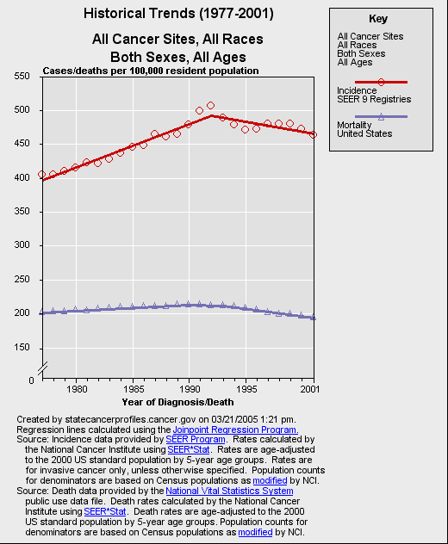
Information Collection
Secondary sources
  Health status data: demographics, vital statistics, hospital records, morbidity and mortality reports
  Cancer Control PLANET (http://cancercontrolplanet._x000b_cancer.gov)
    State Cancer Profiles (NCI, CDC)
  Literature review.

Slide 10



Literature Reviews
Before you begin, ask yourself:
  What is the specific problem or question I want to define?
  What type of literature should I review?
  What issues should I be looking at more closely?
Journals versus magazines:
  Peer review.
Web sites:
  .gov, .org, and .edu versus .com
  Editorial board
  Links
  Update
  Online databases.

Slide 11

Some Useful Web Sites
U.S. Census Bureau: http://www.census.gov
National Center for Health Statistics: http://www.cdc.gov/nchs
State Cancer Profiles: http://statecancerprofiles.cancer.gov (can be accessed through the Cancer Control PLANET Web site, http://cancercontrolplanet.cancer.gov)
American Cancer Society’s Facts and Figures: http://www.cancer.org/docroot/STT/stt_0.asp
See Handout #6: Guide to Secondary Sources.

Slide 12

Your Goal . . .
You will have a better understanding of factors that affect the health of your audience. These include:
  Knowledge, attitudes, and beliefs
  Cultural, religious, and spiritual beliefs
  Environment
  Access to resources
  Competing messages
  Socioeconomic status.

Slide 13
Establish a Baseline
What does your audience know about the causes of the disease?
Do they know the factors that increase or decrease their risk?
Does your audience get screened for the disease?
What other health-driven behaviors does your audience do?

Slide 14

Partnerships
Definition:
The goal of a partnership is to create synergy. This is a state in which each partner is a resource. Together they create a stronger unit. Synergy gives each partner a chance to volunteer his or her strengths, experience, skills, and knowledge in order to achieve what the individual could not do alone.

Slide 15

Degrees of Partnership
Extensive—development through dissemination
Limited—provide channels of delivery that support one or more of the following:
  Implementation
  Evaluation
  Promotion
  Dissemination.

Slide 16
Your Experience
Have you had any successful partnerships with:
  Organizations with competing messages
  Nontraditional program partners.
Did these partners provide useful information about your audience?

Slide 17

Barriers
Competing health messages
  Unhealthy lifestyles
  Other health issues
  Other health-enhancing activities.
Basic needs
  Expenses
  Care-taking.
Education
Fears/misconceptions/stigma.

Slide 18
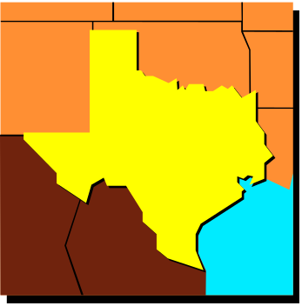
Case Study Activity
Scenario 1: You are a State cancer control planner in Texas and would like to learn about the incidence and mortality of cancer in your State.
  Where can you look?
Scenario 2: You have decided to target your cancer control program to Cameron County, TX.
  What sources of information can you use to learn about the community’s health beliefs, practices, and concerns?
  What sort of terms may be useful for doing an online search?
Scenario 3: You have decided to interview the leaders in your community.
  How do you define a community leader?
  What kinds of questions will you want to ask community leaders in Cameron County, TX?

Slide 19
Objectives
Know how to assess your audience—who they are, what they value, and what factors influence their health.
Be able to find resources and methods for collecting data from first-hand (primary) and second-hand (secondary) sources.
Understand the value of using good data sources to drive your program.
Be able to find other groups and agencies that could assist—or that may compete with—your program efforts.

Slide 20

Questions?

